Slide 1


AI-Based Strategy Builder
& Multi-Factor Confidence Scoring System for Equity Trading
PROJECT PHASE - I
PROJECT GUIDE Dr.MANIKANDAN
B.TECH CSE AIML B
JEYRENTH SIVA-23619212
ROKITH K - 23619228
YESHWANDH D - 23619239

Slide 2
Abstract
A trading strategy is a set of rules for which stocks to buy or sell, and when. This project builds Stratosphere, an AI-assisted platform that lets a user create and test such strategies without writing code. It has three parts: a Strategy Builder, where the user sets rules through simple toggles (price movement, volume, stop-loss, and more) or by describing a strategy in plain English, parsed using constrained semantic parsing onto a fixed rule schema; an AI Signal Scorer, a 4-model ensemble (Gradient-Boosted Trees, Random Forest, Extra Trees, and Ridge Regression) that studies 22 technical indicators per stock and gives one interpretable score from −100 (strongly bearish) to +100 (strongly bullish), with feature importance to explain what drove it; and a Twin Tower AI for Nifty 50 options trading, using a neural Entry Gate to filter contracts and a real-time Exit Manager to close trades intelligently. Both AI modules are validated on data they were never trained on. The scorer is tested on the final 20% of each stock's two-year history across 43 NSE symbols, achieving a direction accuracy of 64.9% against a 50% random baseline (+14.9pp edge). The Twin Tower is validated using 5-fold walk-forward testing across unseen weekly expiries, achieving a 61.1% average win rate and +7.80% average return per trade across 681 simulated trades — confirming the system is genuinely better, not just more complex.

Slide 3
Problem Statement
No interpretability — outputs are single signals; users can't see which factors drove them.
No configurability — indicator choice and weighting live inside the research pipeline, not exposed to the user.
No continuous ranking — stocks get one classification, not a comparable confidence score across a universe.

Slide 4
Base Paper
N. Sukma and C. S. Namahoot, “An Algorithmic Trading Approach Merging Machine Learning With Multi-Indicator Strategies for Optimal Performance,” IEEE Access, vol. 12, pp. 188154–188173, 2024.
Summary: Integrates ML with multiple technical indicators, dynamically selecting and combining them — the same core idea of ML working across indicators together rather than in isolation.
Method: Trains 8 ML classifiers (GBM, SVM, Random Forest, Logistic Regression, ANN, Decision Tree, KNN, Gaussian Naive Bayes) on correlation-filtered technical indicators and selects the best performer — GBM won on every metric (73.1% accuracy). Reported 901% return is a single-stock (Apple) backtest, not portfolio-wide.
No user-facing configuration or explainable output
Signal-based output, not a ranked per-stock confidence score
Not evaluated on Indian (NSE/BSE) equities
4

Slide 5
Objectives-1
Design a Confidence Scanner module combining multiple technical indicators via ML to produce a continuous, signed confidence score (-100 to +100) with a per-decision explanation.
Design a Strategy Builder module allowing strategy construction via a toggle-based interface by mapped to a fixed, backtestable schema.
Integrate the two modules so the Confidence Scanner's ranked output feeds the Strategy Builder as a candidate universe.

Slide 6
Objectives-2
Ensure methodological rigor via walk-forward validation, point-in-time-correct indicators, transaction-cost modeling, and baseline comparisons.
Evaluate the complete system on Indian equity (NSE) data and benchmark against the base paper and literature.
Assess whether a transparent, configurable, explainable system can match or exceed existing black-box approaches.

Slide 7
Literature Survey
No | Paper Title | Study / Approach | Key Gap
1 | “An Algorithmic Trading Approach Merging Machine Learning With Multi-Indicator Strategies for Optimal Performance” — N. Sukma and C. S. Namahoot, 2024 | Combines machine learning with multiple technical indicators and dynamically selects relevant indicators for algorithmic trading. | No user-configurable strategy builder ; mainly focuses on trading performance rather than continuous confidence scoring. (Directory of Open Access Journals)
2 | “Technical Indicator Empowered Intelligent Strategies to Predict Stock Trading Signals” — A. S. Saud and S. Shakya, 2024 | Uses MACD, DMI and KST indicators with LSTM and GRU models to predict stock trading signals. Evaluates performance using return, Sharpe ratio and win rate. | Focuses on predicting trading signals; does not provide a user-configurable strategy builder or an interpretable multi-factor confidence score. (ScienceDirect)
3 | “Synergizing Quantitative Finance Models and Market Microstructure Analysis for Enhanced Algorithmic Trading Strategies” — O. Mengshetti et al., 2024 | Combines RSI, EMA, VWAP and MACD into a multi-indicator algorithmic trading strategy and evaluates it through backtesting on NSE India data. | Uses predefined indicator combinations rather than learned indicator weights; strategy generation or confidence-ranking system. (ScienceDirect)
4 | “Utilizing Supervised Machine Learning and Technical Indicators for Quantitative Trading to Improve Stock Market Trading Decisions” — S. K. Sahu et al., 2025 | Compares supervised ML/DL classifiers using technical indicators to generate LONG/SHORT signals for NSE intraday trading. | Produces directional trading signals rather than a continuous explainable confidence score; does not provide an interactive strategy-building interface. (ResearchGate)
5 | “BacktestBench: Benchmarking Large Language Models for Automated Quantitative Strategy Backtesting” — Z. Wang et al., 2026 | Introduces an LLM benchmark and AutoBacktest framework for translating natural-language quantitative strategies into reproducible backtests using a multi-agent approach. | Strong focus on NL-to-backtest automation, but does not focus on a multi-indicator confidence-scoring layer that learns indicator importance for stock ranking. (arXiv)

Slide 8
Proposed system
A
Strategy Builder
B
Confidence Scanner
Toggle UI: curated set of parameters (price action, volume, stop-loss, and more)
Every strategy produced — however specified — is valid and backtestable
Shared backtest engine: walk-forward validation, transaction costs
Bank of indicators, combined into one prediction
Signed confidence score: −100 (bearish) to +100 (bullish)
Output ranks candidates for the Strategy Builder to act on

Slide 9
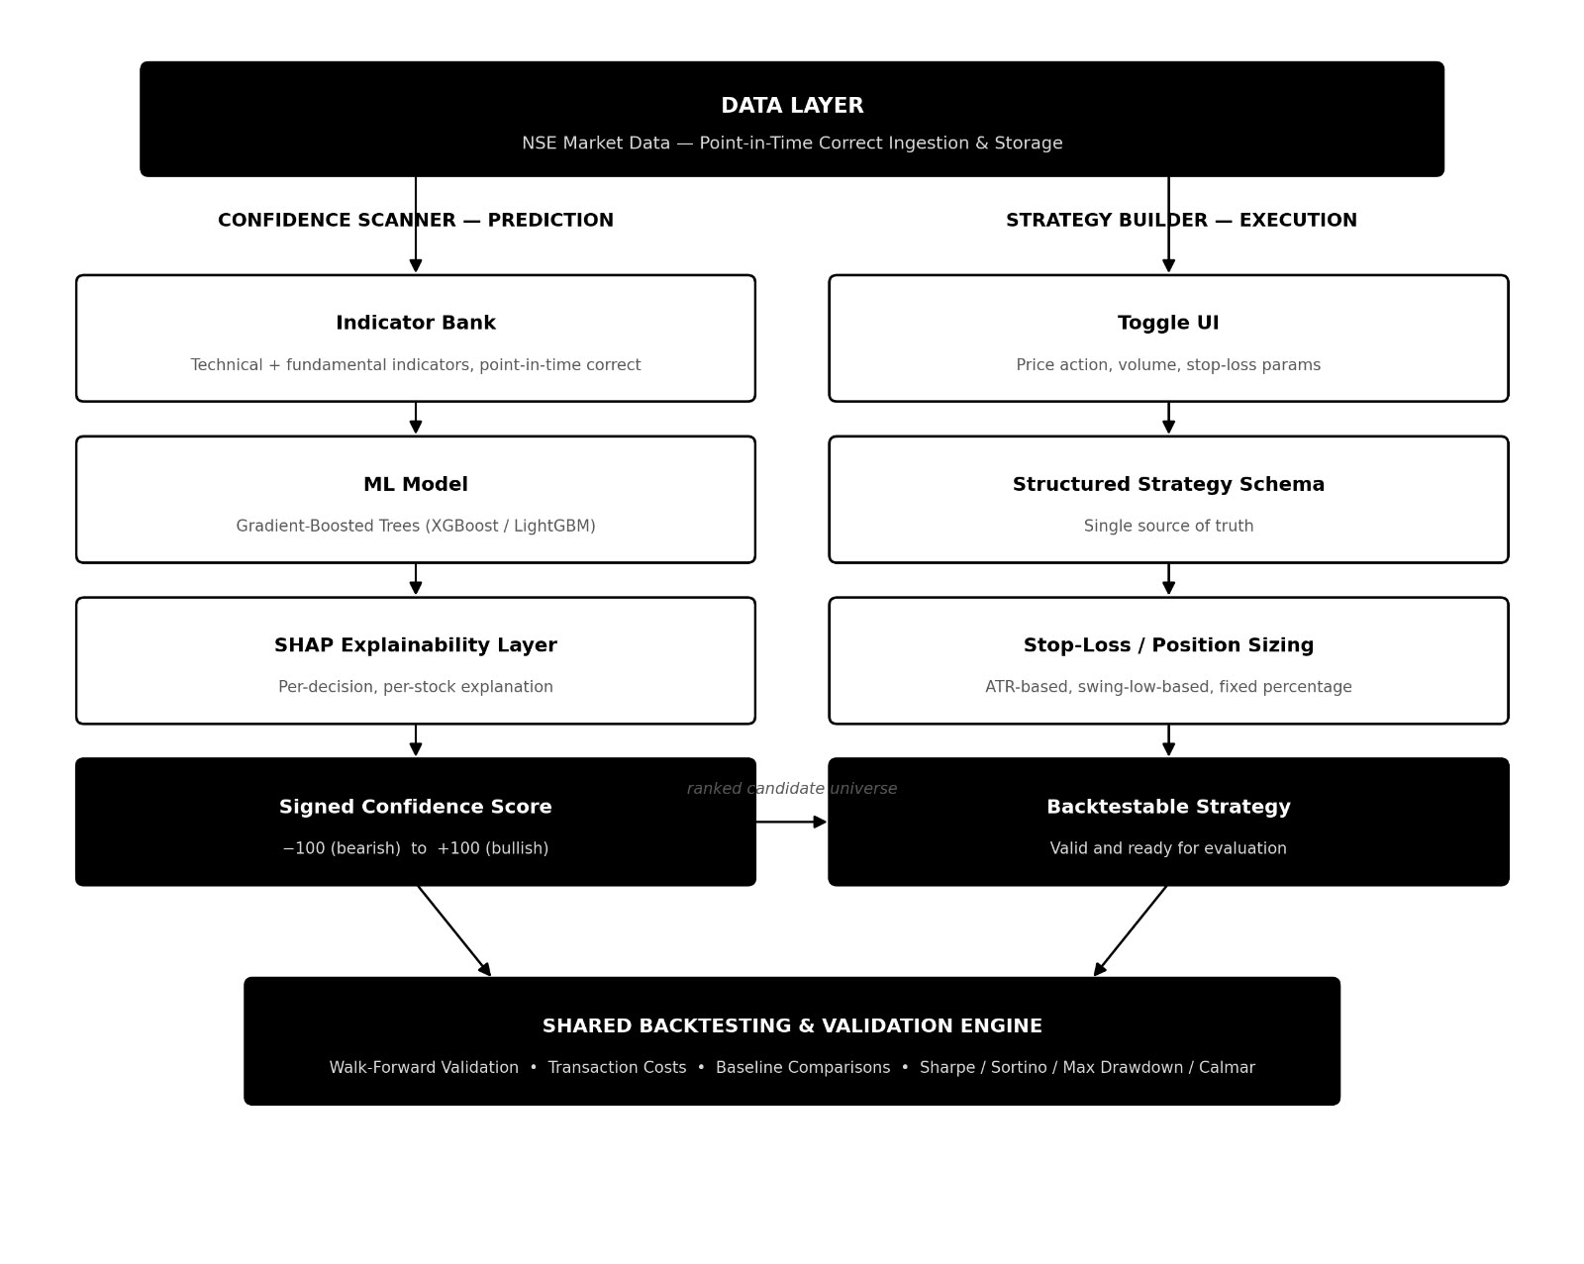

Slide 10
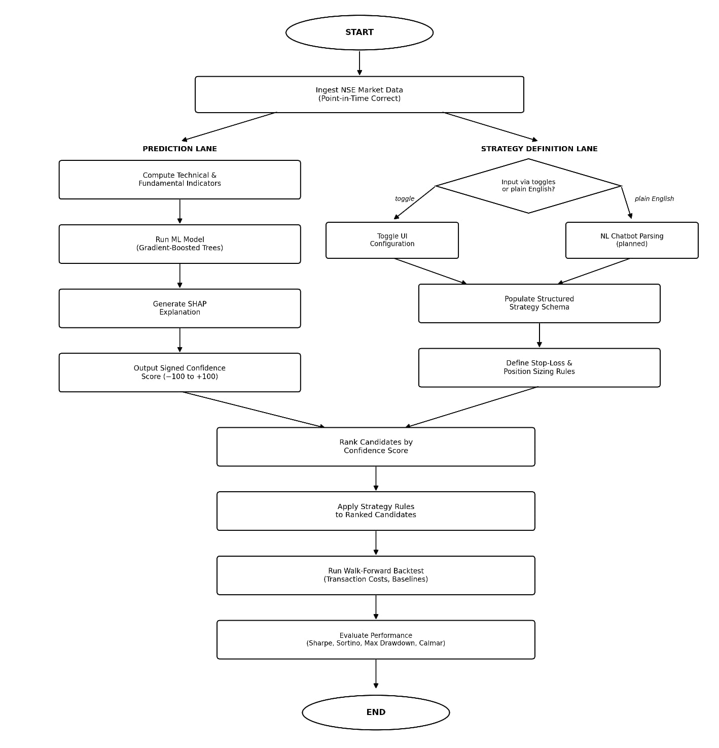
Flow chart

Slide 11
Module
Module 1 – Strategy Builder: lets a user construct a trading strategy through a toggle interface , mapped onto a fixed, backtestable schema.
Module 2 – Confidence Scanner: combines a bank of technical indicators via a learned-weight ML model to produce a signed, explainable confidence score per stock.
Module 3 – Backtesting & Evaluation Engine: shared by both modules; runs walk-forward validation, point-in-time-correct indicators, and transaction-cost modeling.

Slide 12
Module-1
Toggle UI exposes a curated set of parameters — price action, volume, stop-loss, and other rule types — for building a strategy without code.
Conversational interface lets the user describe a strategy in plain English instead of setting toggles manually.
Mapping the description onto the same fixed toggle schema so every parsed strategy stays valid.
Output is a structured, backtestable strategy configuration — identical in shape whether it came from toggles or natural language — passed to the shared Backtesting Engine.

Slide 13
Module-2
Computes a bank of independent technical indicators (trend, momentum, volatility, volume) for each stock in the chosen universe.
Treats each indicator as an interpretable vote; a Gradient-Boosted Trees model learns the relative weight of each from historical backtested performance.
SHAP values attach a plain explanation to every score, showing which indicators drove it — not just a single opaque classification.
Outputs a continuous, signed confidence score from –100 (strongly bearish) to +100 (strongly bullish) for every stock, ranking the universe for the Strategy Builder.

Slide 14
Module-3
Shared by both modules, so every strategy and every confidence score is evaluated the same way.
Walk-forward validation and point-in-time-correct indicator computation guard against look-ahead bias and overfitting.
Transaction-cost modeling (brokerage, slippage)keeps backtested performance realistic for Indian equity markets.
Benchmarks results against buy-and-hold, equal-weighted indicator voting, and the base paper's ML approach.

Slide 15
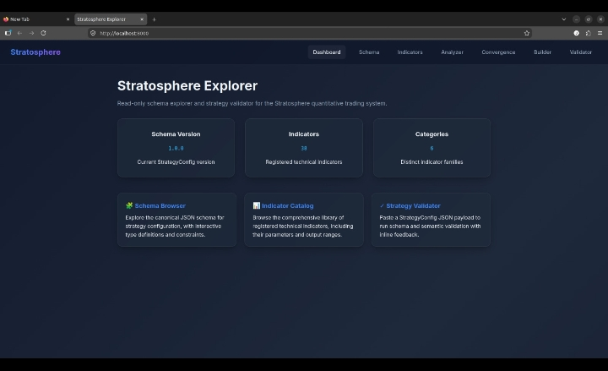
Implementation

Slide 16
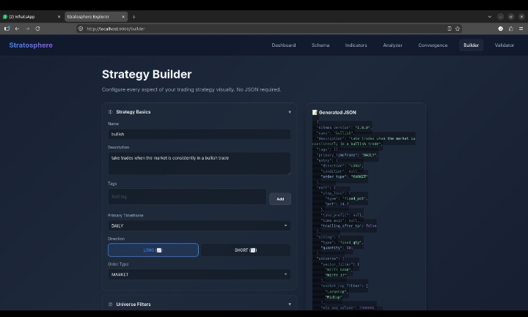

Slide 17
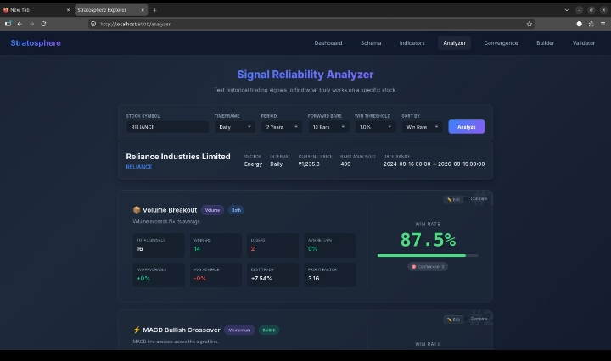

Slide 18
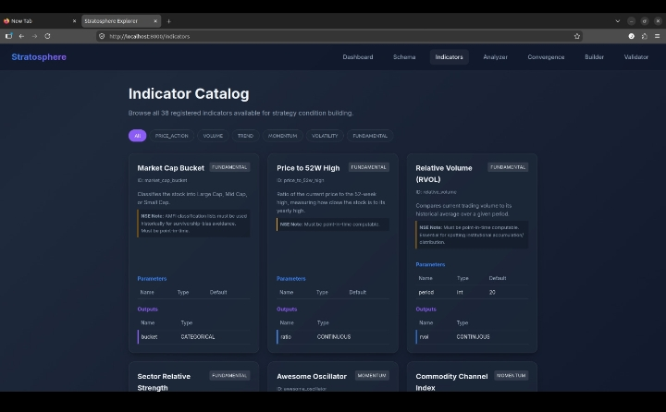

Slide 19
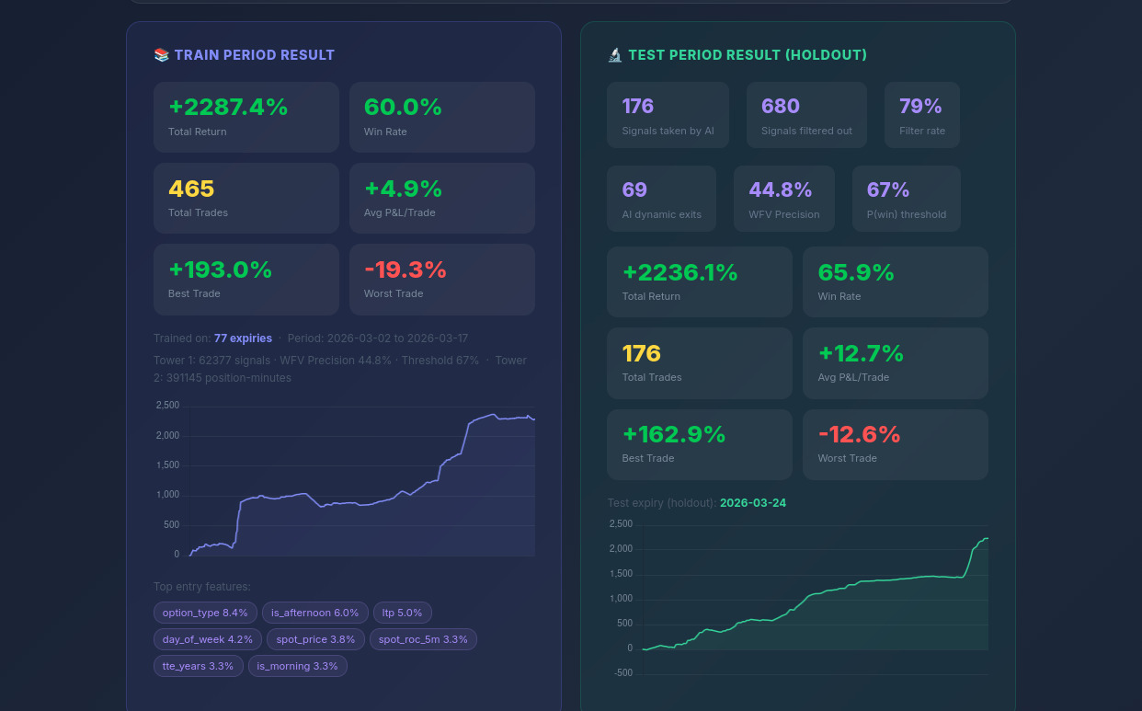

Slide 20
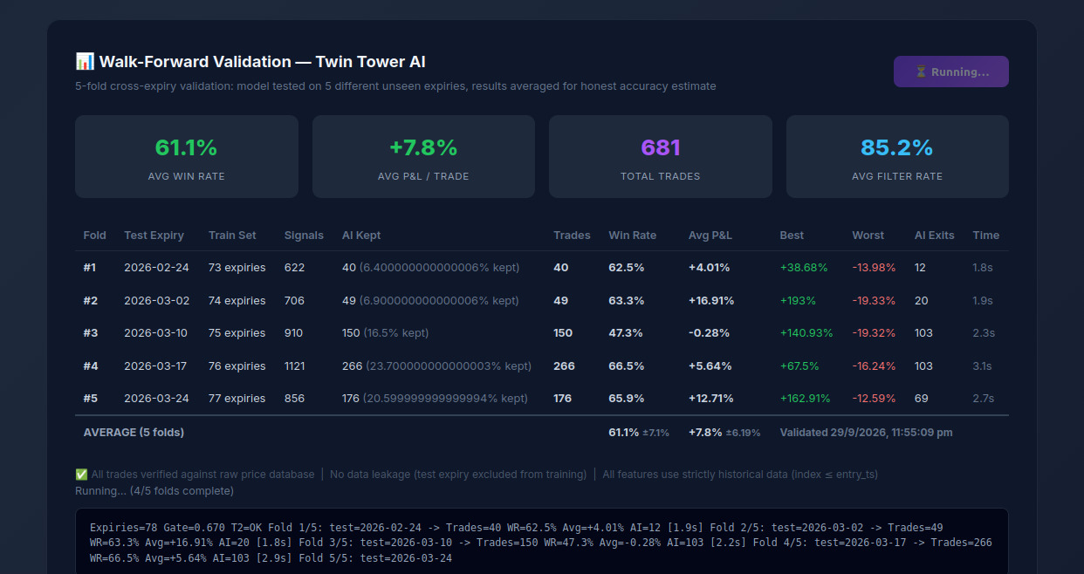

Slide 23
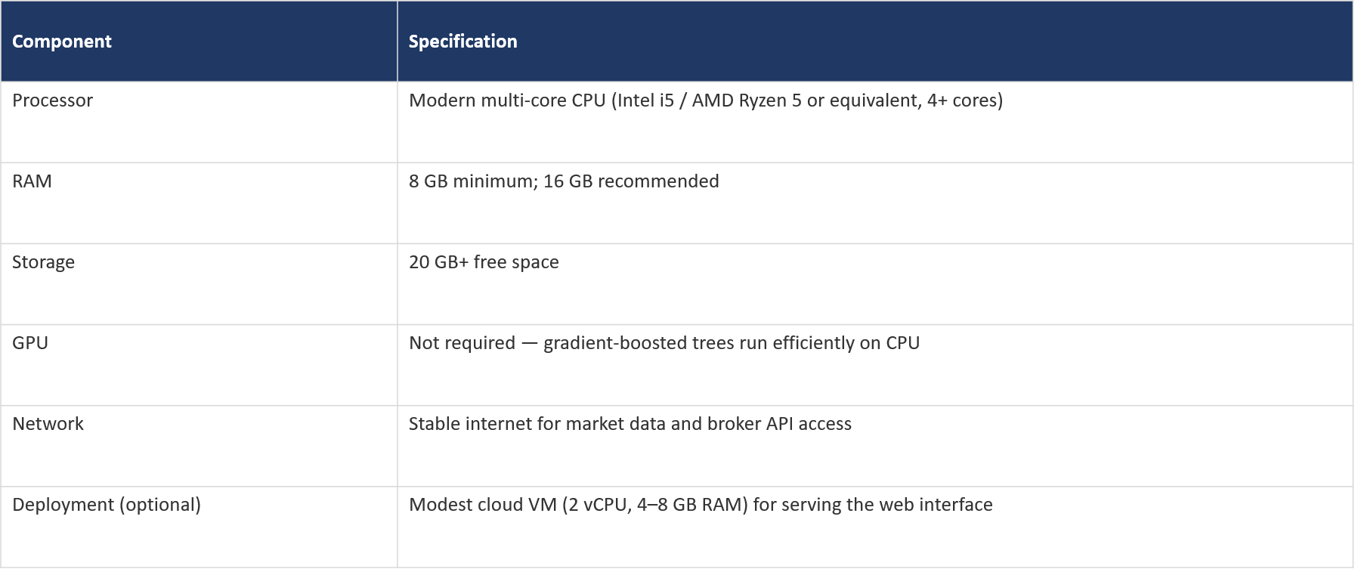
Hardware Requirements

Slide 24
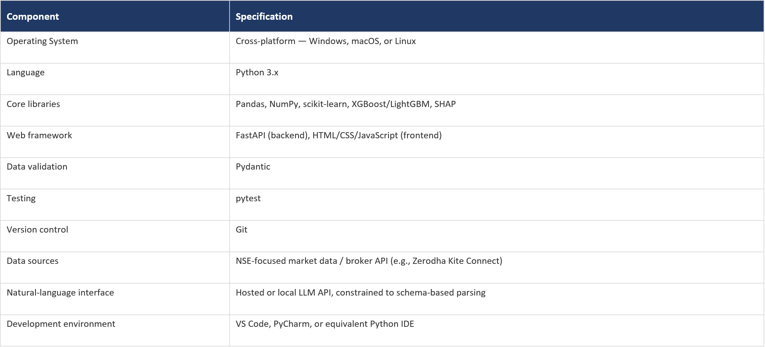
Software Requirements

Slide 25
Result & Discussion
Evaluation plan: backtest both modules on historical NSE equity data over a multi-year, out-of-sample window using walk-forward validation.
Baselines: buy-and-hold, equal-weighted indicator voting, and the base paper's best-performing classifier (GBM).
Metrics: backtested return, Sharpe ratio, max drawdown, and win rate for the Strategy Builder; directional accuracy of the score for the Confidence Scanner.
Status: Strategy Builder and Confidence Scanner prototypes are functional, with SHAP explanations already showing which indicators drive each score; full walk-forward benchmarking against all baselines is in progress.

Slide 26
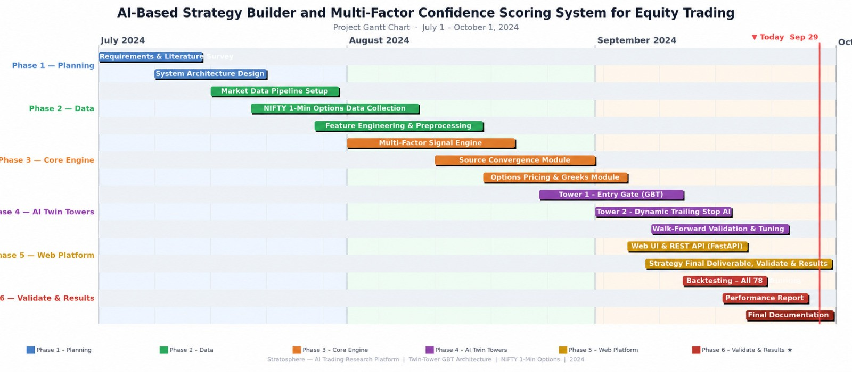
Gantt chart

Slide 27
Challenges faced
Guaranteeing point-in-time-correct indicator computation from historical NSE data, so backtests never leak future information (look-ahead bias).
Sourcing reliable, affordable historical NSE data at the depth needed for walk-forward validation, and keeping SHAP explanations fast enough for a full stock universe.
Choosing transaction-cost assumptions (brokerage, slippage, STT) realistic enough that backtested performance isn't overstated.

Slide 28
Future work
Extend the Confidence Scanner to other instrument classes — F&O, and eventually broader asset classes beyond NSE equities.
Add portfolio-level optimization (position sizing, correlation-aware allocation) on top of individual per-stock confidence scores.
Integrate a broker API for live or paper trading, moving beyond backtesting.
Incorporate alternative data — news sentiment, earnings-call transcripts — as additional indicator inputs to the Confidence Scanner.
Support periodic re-training of indicator weights so the model adapts as market regimes shift.

Slide 29
Reference
N. Sukma and C. S. Namahoot, “An Algorithmic Trading Approach Merging Machine Learning With Multi-Indicator Strategies for Optimal Performance,” IEEE Access, vol. 12, pp. 188154–188173, 2024. DOI: 10.1109/ACCESS.2024.3516053.
C. Worasucheep, “Ensemble Classifier for Stock Trading Recommendation,” Applied Artificial Intelligence, vol. 36, no. 1, 2023’
S. K. Sahu et al., “Utilizing Supervised Machine Learning and Technical Indicators for Quantitative Trading to Improve Stock Market Trading Decisions,” SN Computer Science, vol. 6, art. 498, 2025.
Z. Wang et al., “BacktestBench: Benchmarking Large Language Models for Automated Quantitative Strategy Backtesting,” arXiv preprint arXiv:2605.17937, 2026.
D. Muhammad, I. Ahmed, K. Naveed, and M. Bendechache, “An Explainable Deep Learning Approach for Stock Market Trend Prediction,” Heliyon, vol. 10, no. 21, e40095, 2024. DOI: 10.1016/j.heliyon.2024.e40095.

Slide 30
Thank You

